Slide 1




tliQ Hardware
Consumer Goods
Ad- Hoc Insights
By - Yogananda Gopi Krishna

Slide 2

1
About company
2
Familiar with input data
Agenda
3
Key variables
4
Ad-hoc requests

Slide 3
About company
About company
Atliq Hardware's, a leading computer hardware producer, needs better insights for data-driven decision-making and plans to expand their data analytics team.
Task
As an applicant, review 10 ad hoc business requests from ‘ad-hoc-requests.pdf,’ run SQL queries to derive insights, and create a presentation for top-level management.
Approach
Analyze the requests using SQL, extract relevant data, and present the insights in a clear, concise presentation tailored for executive decision-makers.

Slide 4
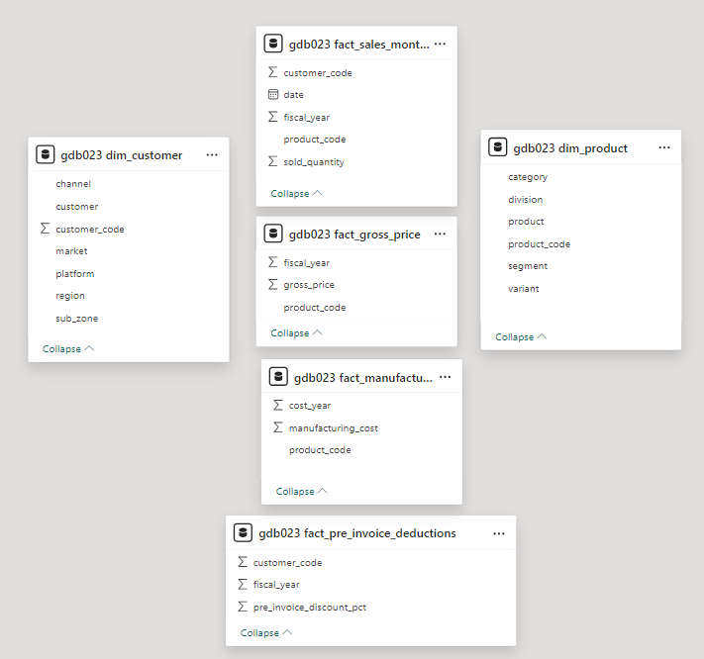
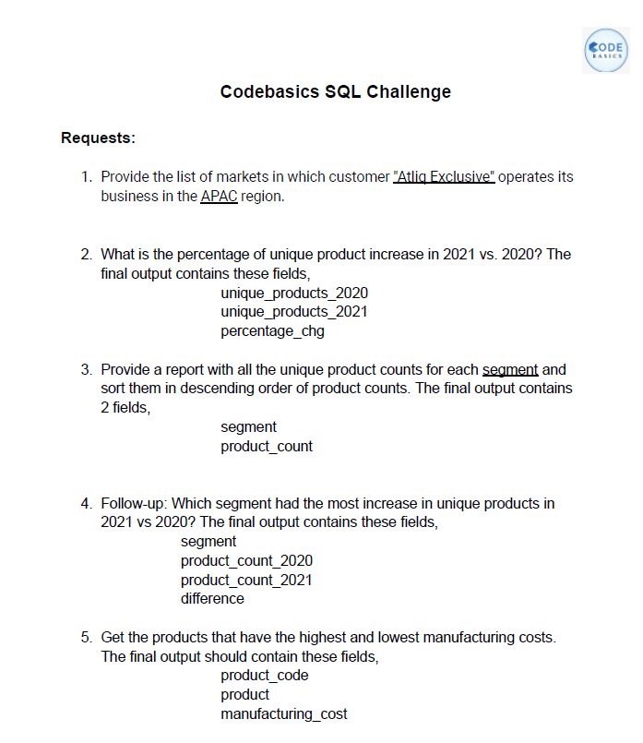
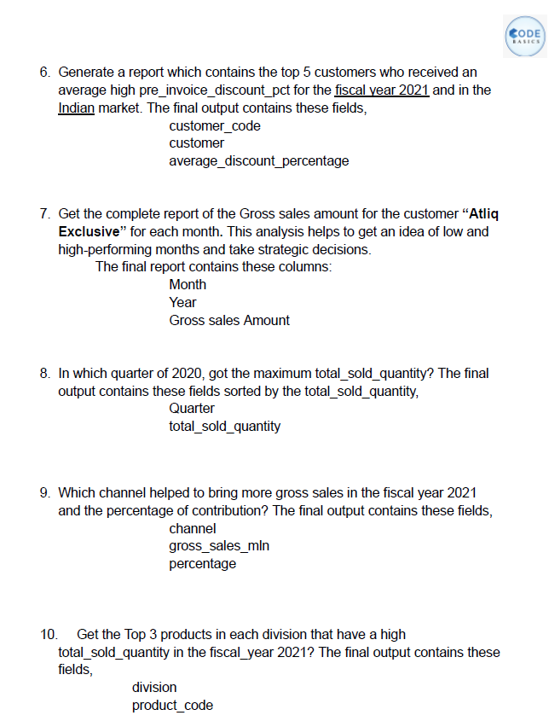



Familiar with input data
Tools and Technology used :

Slide 5
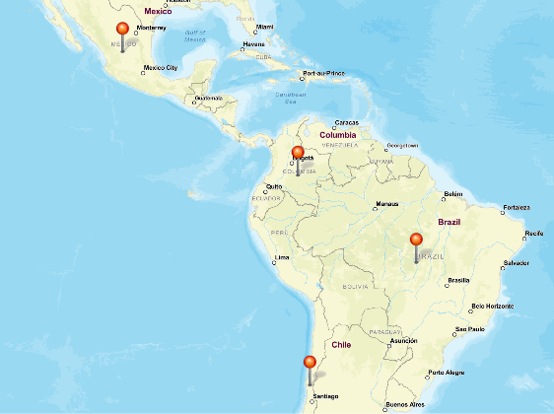
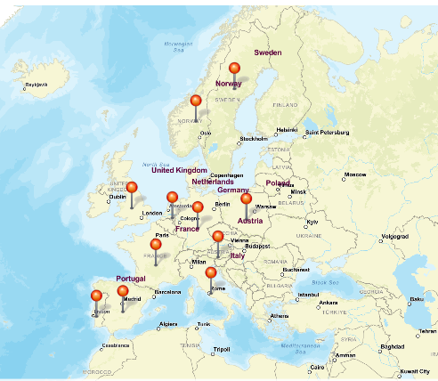
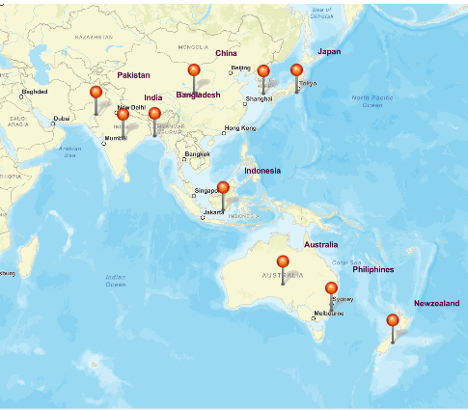
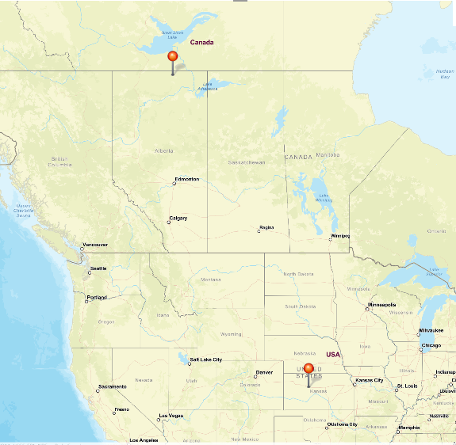
Key variables - dim Customer
Channel
Platform
Retailer
Direct
Distributor
Brick & Motor
E-commerce
EU
NA
LATAM
APAC

Slide 6
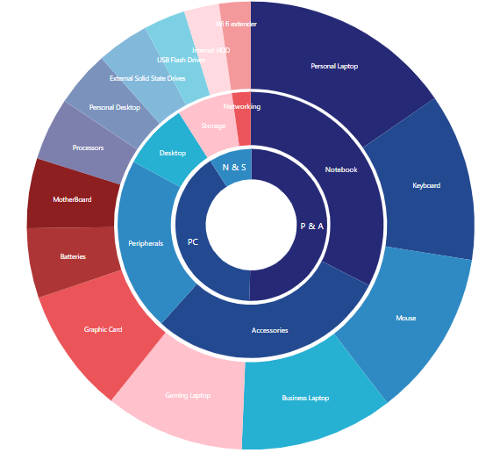


Key variables – dim products
Division
Segment
Category

Slide 7

Ad-hoc Requests

Slide 8
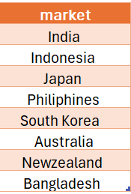
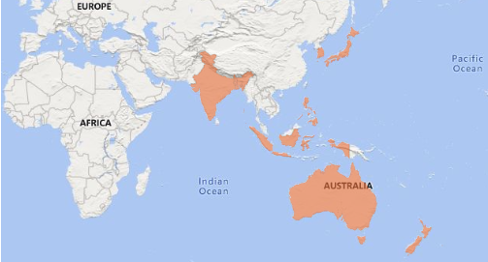
1. Provide the list of markets in which customer "Atliq Exclusive" operates its business in the APAC region.
SELECT DISTINCT
market
FROM
dim_customer
WHERE
customer = 'Atliq Exclusive'
AND region = 'APAC';

Slide 9
WITH Unique_products AS (
SELECT
fiscal_year,
count(DISTINCT product_code) AS uniq_products
FROM fact_gross_price
GROUP BY fiscal_year
),
compare_uni_year AS (
SELECT
MAX(CASE WHEN fiscal_year =2020 THEN uniq_products END) AS Unique_products_2020,
MAX(CASE WHEN fiscal_year =2021 THEN uniq_products END) AS Unique_products_2021
FROM
Unique_products)
SELECT
unique_products_2020,
unique_products_2021,
CONCAT(ROUND((unique_products_2021 - unique_products_2020)/unique_products_2020*100,2)," %") as chg
FROM compare_uni_year
2. What is the percentage of unique product increase in 2021 vs. 2020?

Slide 10

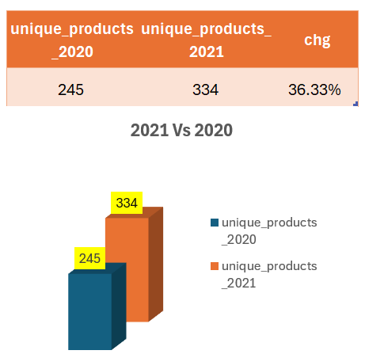
36.33%
AtliQ Hardware achieved a 36.33% increase in unique products sold, rising from 245 in 2020 to 334 in 2021. This growth demonstrates a successful expansion of our product portfolio and market reach.

Slide 11
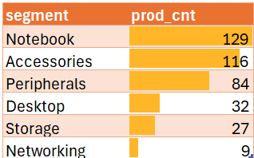
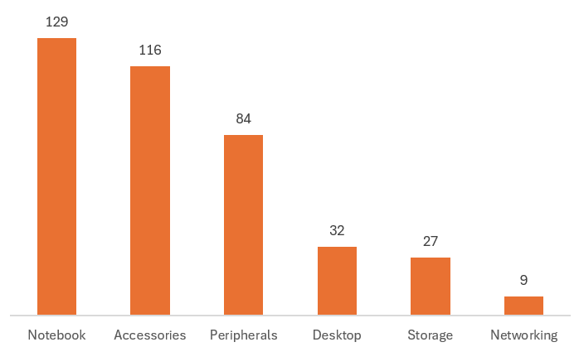
3. Provide a report with all the unique product counts for each segment and sort them in descending order of product counts.
SELECT
segment,
COUNT(DISTINCT(product_code)) as prod_cnt
FROM dim_product
GROUP BY segment
ORDER BY prod_cnt DESC;
Top Business segments (82.9%)
Low Business segments (17.1%)

Slide 12
WITH prod_cnt AS (
SELECT
gp.fiscal_year,
p.segment,
COUNT(DISTINCT(p.product_code)) as uniq_prod_cnt
FROM dim_product p
JOIN fact_gross_price gp
USING (product_code)
GROUP BY p.segment,gp.fiscal_year
ORDER BY uniq_prod_cnt DESC),
fy_prod_cnt AS (
SELECT
segment,
MAX(CASE WHEN fiscal_year = 2020 then uniq_prod_cnt END) AS product_count_2020,
MAX(CASE WHEN fiscal_year = 2021 then uniq_prod_cnt END) AS product_count_2021
FROM prod_cnt
GROUP BY segment
)
SELECT
segment,
product_count_2020,
product_count_2021,
product_count_2021 - product_count_2020 as difference
FROM fy_prod_cnt
ORDER BY difference DESC;
4. Which segment had the most increase in unique products in 2021 vs 2020?

Slide 13
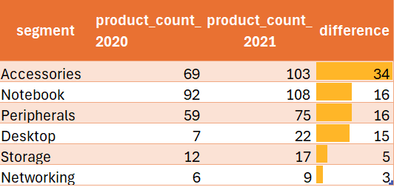
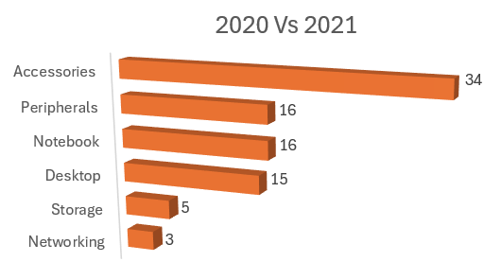
Accessories saw the most significant rise in unique products, increasing by 34, whereas Networking had the smallest growth of 3. This disparity highlights areas of strong performance and those requiring further development to balance growth across segments.(resource allocation and marketing)

Slide 14
SELECT
p.product_code, p.product, CONCAT("$ ",ROUND(manufacturing_cost,2)) AS manufacturing_cost
FROM
fact_manufacturing_cost m
JOIN
dim_product p USING (product_code)
WHERE
manufacturing_cost = (SELECT
MAX(manufacturing_cost) AS max_1
FROM
fact_manufacturing_cost)
OR manufacturing_cost = (SELECT
MIN(manufacturing_cost) AS min_1
FROM
fact_manufacturing_cost)
5. Get the products that have the highest and lowest manufacturing costs.

Slide 15
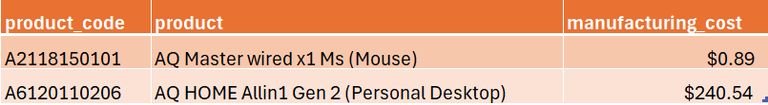
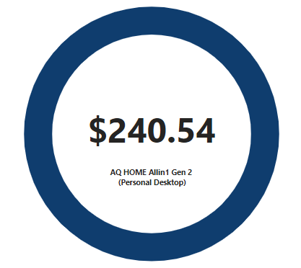
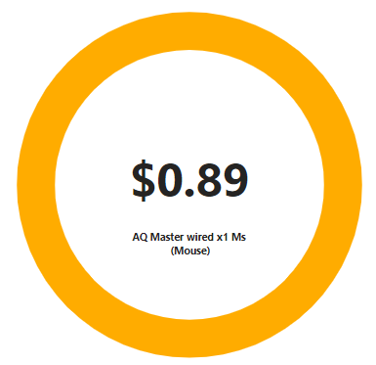
Highest manufacturing cost Product
Least manufacturing cost Product
AQ HOME Allin1 Gen 2 from Personal desktop category had the highest manufacturing cost at $240.54, while AQ Master wired x1 Ms from Mouse Category had the lowest at $0.89. Understanding these cost extremes aids in evaluating cost efficiency and pricing strategies

Slide 16
WITH avg_prein_disc_cust AS (
SELECT
customer_code, AVG(pre_invoice_discount_pct) AS Avg_prein_disc
FROM
fact_pre_invoice_deductions
WHERE
fiscal_year = 2021
GROUP BY customer_code
)
SELECT
c.customer_code, customer, CONCAT(ROUND(Avg_prein_disc*100,2)," %") AS avg_disc_pct
FROM
avg_prein_disc_cust
JOIN
dim_customer c USING (customer_code)
WHERE
market = 'india'
ORDER BY Avg_prein_disc DESC
LIMIT 5;
6. Generate a report which contains the top 5 customers who received an average high pre_invoice_discount_pct for the fiscal year 2021 and in the Indian market.

Slide 17
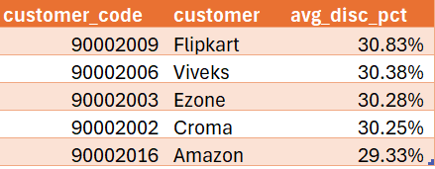
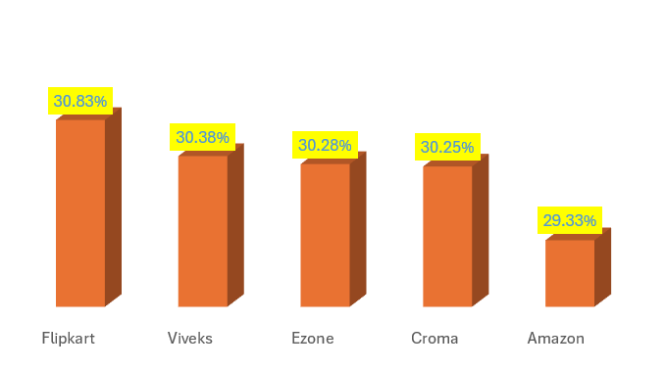
Flipkart received the highest average pre-invoice discount of 30.83%, enhancing its profitability compared to Amazon, which had a lower average discount of 29.33%. This information can be leveraged to optimize discount strategies and strengthen customer relationships.

Slide 18
WITH gross_sale_amt_cte AS (
SELECT
customer_code,
concat(MONTHNAME(sm.date),
YEAR(date)) as month_year,
sm.fiscal_year,
(sm.sold_quantity * gp.gross_price) AS gross_sales_amt
FROM
fact_gross_price gp
JOIN
fact_sales_monthly sm USING (product_code)
)
SELECT
month_year, fiscal_year, CONCAT("$",ROUND(sum(gross_sales_amt/1000000),2)," M") AS gross_sales_amt_mln
FROM
gross_sale_amt_cte
JOIN
dim_customer USING (customer_code)
WHERE
customer = 'Atliq Exclusive'
GROUP BY fiscal_year,month_year
7. Get the complete report of the Gross sales amount for the customer “Atliq Exclusive” for each month . This analysis helps to get an idea of low and high-performing months and take strategic decisions.

Slide 19
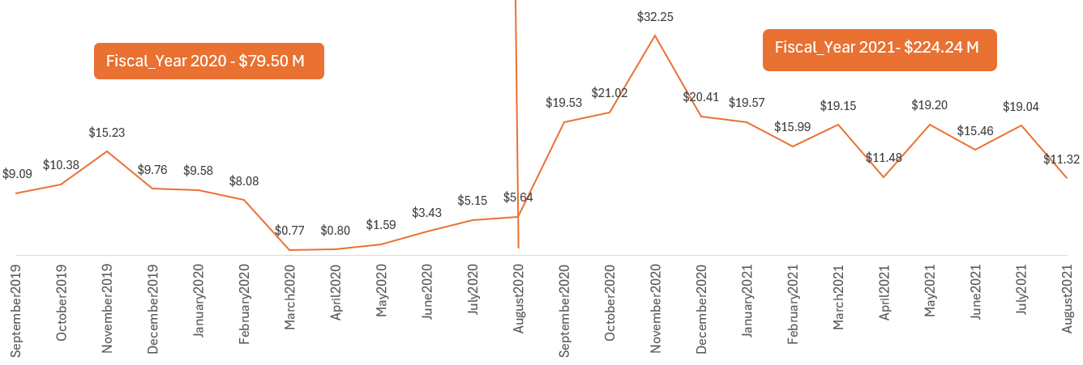
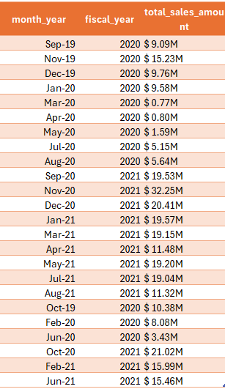


Top performance
Least performance
March was the lowest-performing month for gross sales in both fiscal years 2020 and 2021, while November achieved the highest sales. The significant increase in total gross sales from 70.5M in 2020 to 224.55M in 2021 highlights successful sales strategies and seasonal trends that can inform future business planning.

Slide 20
WITH cte AS (
SELECT
CASE
WHEN MONTH(date) IN (9, 10, 11) THEN 'Q1'
WHEN MONTH(date) IN (12, 1, 2) THEN 'Q2'
WHEN MONTH(date) IN (3, 4, 5) THEN 'Q3'
WHEN MONTH(date) IN (6, 7, 8) THEN 'Q4'
END AS quarter,
sold_quantity
FROM
fact_sales_monthly
WHERE
fiscal_year = 2020
)
SELECT
quarter,
concat(round(SUM(sold_quantity)/1000000,2),"M") AS total_sold_quantity
FROM
cte
GROUP BY
quarter
ORDER BY
total_sold_quantity DESC;
8. In which quarter of 2020, got the maximum total_sold_quantity?

Slide 21
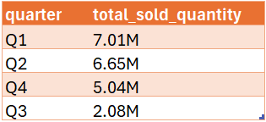
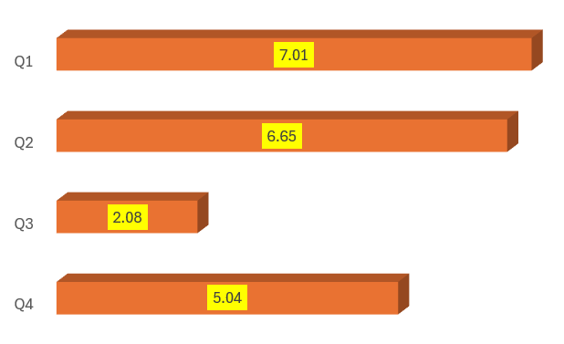
Maximum sold quantity
Q1 had the highest total sold quantity at 7.01M units, whereas Q3 recorded the lowest at 2.08M units. This variation suggests the need for targeted strategies to address seasonal fluctuations and optimize sales performance throughout the year.
Least sold quantity

Slide 22
with gs_channel AS (
SELECT
channel, SUM(sold_quantity * gross_price) AS gross_sales
FROM
dim_customer c
JOIN
fact_sales_monthly USING (customer_code)
JOIN
fact_gross_price USING (product_code , fiscal_year)
WHERE
fiscal_year = 2021
GROUP BY channel
),
Total_gs AS (
SELECT
SUM(gross_sales) AS total_gross_sales
FROM
gs_channel
)
SELECT
gs_channel.channel,
CONCAT("$ ",ROUND(gs_channel.gross_sales / 1000000, 2)," M") AS gross_sales_mln,
CONCAT(ROUND(gs_channel.gross_sales * 100 / Total_gs.total_gross_sales,
2)," %") AS percentage
FROM
gs_channel,
Total_gs
ORDER BY percentage DESC;
9.Which channel helped to bring more gross sales in the fiscal year 2021 and the percentage of contribution?

Slide 23
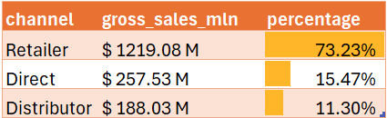
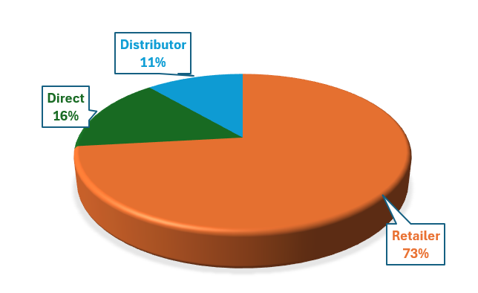
The Retailer channel was the leading contributor to gross sales, accounting for 73.23%, while Direct and Distributor channels contributed 15.47% and 11.30%, respectively. This distribution underscores the importance of the Retailer channel in driving revenue and suggests opportunities for enhancing the performance of other channels.

Slide 24
WITH cte AS (
SELECT
division,
product_code,
product,
SUM(sold_quantity) AS Total_sold_qty
FROM
dim_product
JOIN
fact_sales_monthly USING (product_code)
WHERE
fiscal_year = 2021
GROUP BY division , product_code , product
),
cte_2 AS (
SELECT
* ,
DENSE_RANK() OVER(PARTITION BY division ORDER BY total_sold_qty DESC) AS rank_order
FROM cte
)
SELECT
*
FROM cte_2
WHERE rank_order <= 3;
10. Get the Top 3 products in each division that have a high total_sold_quantity in the fiscal_year 2021?

Slide 25
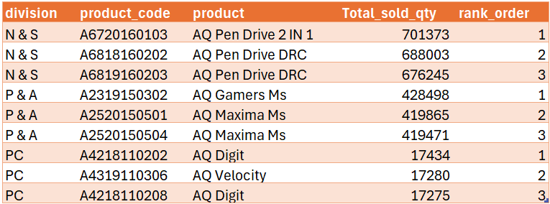
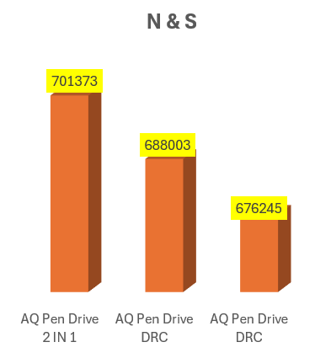
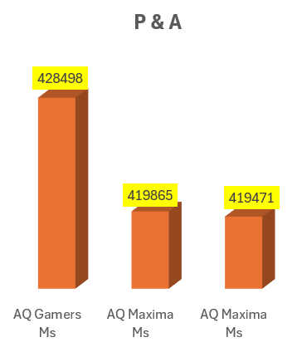
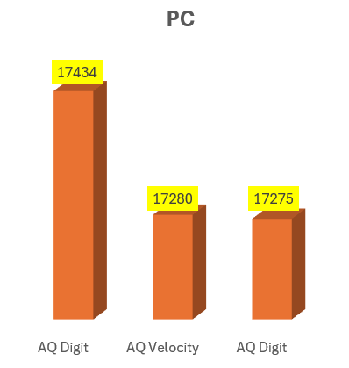

Slide 26


Acknowledgements
Thank you, Hemanand Vadvel and Dhavel Patel, for this incredible opportunity. I appreciate your guidance and support throughout this project.
Hemanand Vadvel as Tony sharma
Dhavel Patel as Peter Pandey
A special mention to Aryan Sharma and Shazin Ashraf. I have taken inspiration from your projects.

Slide 27
Thank you
Kindly give your valuable feedback and suggestions

